Slide 1
Biochem 3BP3 Gene Expression Analysis

Slide 2
Gene Expression Analysis
Gene Expression Analysis used primarily for two purposes:
Determine genetic underpinnings of observed phenotype – experimental
Annotation of genomes – development of gene models (intron/exon)
The complete set of RNAs in a cell is called the “Transcriptome”
Transcriptomes are dynamic while genomes are static
the transcriptome will vary among cells, organs, life-stages, over time
many transcriptome libraries are needed for a full sampling
cell sorting technologies + NGS = single cell transcriptomics
Transcriptome analysis is both genomic and statistical in methodology

Slide 3
Gene Expression Analysis
For most studies, transcriptome = mRNA
rRNA is ignored as it dominates the transcriptome and would overwhelm library construction & sequencing
mRNA is sampled exclusively via isolation of polyadenylated RNA during library construction
transcriptome = mRNA = protein-coding portion of the genome
A transcriptome sample represents a steady-state of active transcription, actively translated mRNA (translation rates vary), miRNA bound mRNA, and active + passive degradation of mRNA
transcriptome ≠ proteome
Increasingly, studies sample:
total mRNA
ribosome-bound mRNA (i.e. actively translated)
miRNA (i.e. post-transcriptional regulation)

Slide 4
Gene Expression Analysis
Transcriptome studies lead to new knowledge about active biological processes, pathways, and networks
Often lead to new experiments to determine regulatory basis and mechanism for observed transcriptome (regulatory proteins? gene methylation patterns?)
Transcriptome studies are often exploratory – the beginning of a longer research arc
Transcriptomes can be sampled and measured in two ways:
INDIRECT = probe based technologies = microarrays
DIRECT = sequencing technologies = RNA-Seq

Slide 5
Direct Sampling
Started before we were sequencing genomes with the construction and Sanger sequencing of cDNA libraries
long reads but only a small number of them (i.e. thousands at best)
cDNA libraries normalized so all mRNA were equally abundant – sequencing was about sampling a broad diversity of mRNA but not about relative abundance
1990s – Serial Analysis of Gene Expression (SAGE)
Higher volume isolation of 14 bp or 21 bp tags from mRNAs
Tags mapped to a known genome sequence (required!)
Sampling of 10s of thousands of mRNA
Relative abundance information captured
RNA-Seq (focus of next week)
NGS of mRNA libraries
Millions of mRNA sampled
Gene identification and relative abundance data

Slide 6
Indirect Sampling
Hybridization of mRNA samples to a set of pre-defined DNA probes
Probes designed based on known gene sequences – not a complete sampling of the transcriptome
More abundant mRNA molecules will bind more frequently to probes = higher signal (usually fluorescent); signal is used a proxy for relative abundance
Original “microarrays” involved robotic spotting or in situ synthesis of probes on glass slides
NGS was expected to make microarray technology obsolete but new BeadChip approaches have improved accuracy and very competitive cost
For example, human muscle biopsy transcriptomics @ McMaster:
RNA-Seq – $540 / sample – 25 million mRNA sequenced
HT-12 BeadChip – $178 / sample – 47,000 probes

Slide 7

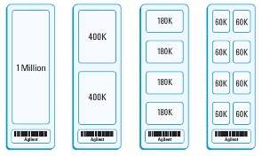
Glass Slide Microarrays
High density probe arrays – many formats

Slide 8
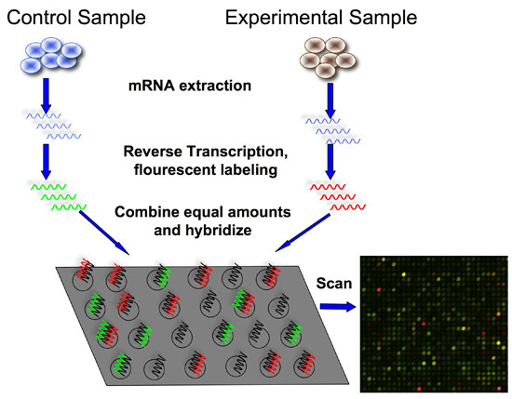
Microarrays – Two-Dye Methods
Sample 1
Sample 2
Cy3
Cy5

Slide 9
Microarrays – Two-Dye Methods
Sample 1
Sample 2
Cy3
Cy5
Cy3 – green, 532 nm
Cy5 – red, 635 nm

Slide 10
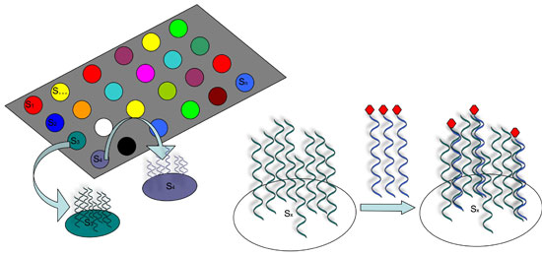
Microarrays – Two-Dye Methods
Each spot is a collection of thousands of identical probes
The more mRNA that bind to a probe within a spot, the brighter the overall signal for that spot

Slide 11
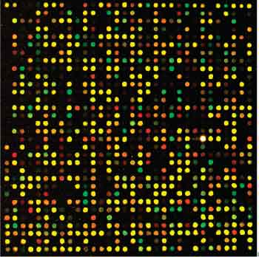
Microarrays – Two-Dye Methods
Cy3
Cy5
Cy3 – green, 532 nm
Cy5 – red, 635 nm

Slide 12
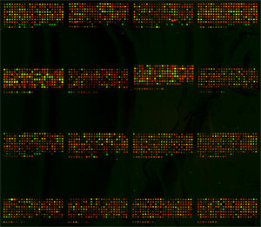
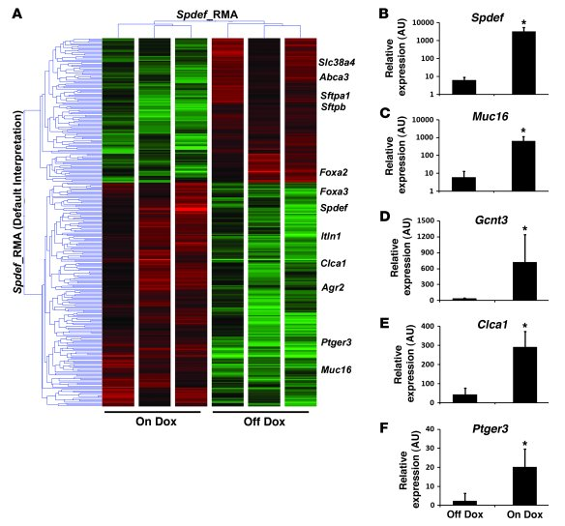
Microarrays – Two-Dye Methods
Fold change between the two samples is calculated
GREEN – downregulated
RED - upregulated
Treatment 1
Treatment 2

Slide 13
Flow Chart
cDNA synthesis and Cy3/5 labeling
Hybridize to Microarray
RNA extraction
Dry & Scan
Feature Extraction
Data Transformations & Adjustments
Normalization
Data Filtering
Statistical Tests
Post-hoc Tests
Visualization

Slide 14
Flow Chart
cDNA synthesis and Cy3/5 labeling
Hybridize to Microarray
RNA extraction
Dry & Scan
Feature Extraction
Data Transformations & Adjustments
Normalization
Data Filtering
Statistical Tests
Post-hoc Tests
Visualization

Slide 15
Feature Extraction
Vendor Software
Spot finding
Outlier detection
Measure feature intensity (Cy3 and/or Cy5)
Background Subtraction or Detrending
Commercial microarrays make extensive use of internal control probes

Slide 16
Feature Extraction
Vendor Software
Spot finding
Outlier detection
Measure feature intensity (Cy3 and/or Cy5)
Background Subtraction or Detrending
Commercial microarrays make extensive use of internal control probes
Two-Dye Approaches - Normalization
Human error and imprecision of tools leads to slightly different loading of Cy3 labeled cDNA and the Cy5 labeled cDNA on the microarray
Normalization attempts to factor out this technical variation
Normalize within microarrays (Cy3 versus Cy5 load)
Normalize among microarrays (each microarray will have slightly different loadings)
Lowess normalization most commonly used (see Flash Update)

Slide 17
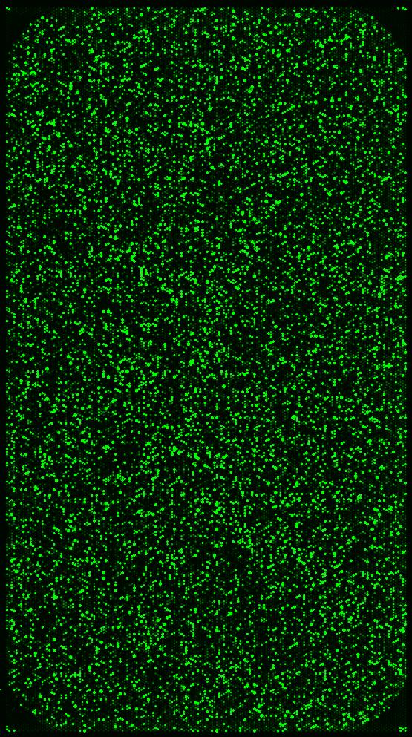
Single Sample Approaches (One-Dye)
Single sample approaches best for high quality microarrays & BeadChip technologies
Each sample is hybridized to its own microarray
You rarely see two-dye approaches anymore
Only uses Cy3 and thus saves money on dye usage
Cy3 is also more stable to laboratory ozone
Avoids difficult statistical properties of fold change estimates
Measurement is the intensity of Cy3 for each sample – how bright is the green?
BaP Replicate #1
Cy3
hyb #1
hyb #2
Cy3
DMSO Replicate #1

Slide 18
Normalization
Cy3 labeled cRNA
Cy3 labeled cRNA
Cy3 labeled cRNA
Each sample is hybridized to its own microarray
Dye normalization is needed to factor out microarray loading error
Non-linear scaling method based on rank invariant probes (see lab)
Result is reliable estimates of relative transcript abundance not fold change estimates
BaP Replicate #1
BaP Replicate #2
BaP Replicate #3
hybridization #5
hybridization #1
hybridization #6
hybridization #4
hybridization #3
hybridization #2
DMSO Replicate #1
DMSO Replicate #2
DMSO Replicate #3
Cy3 labeled cRNA
Cy3 labeled cRNA
Cy3 labeled cRNA

Slide 19
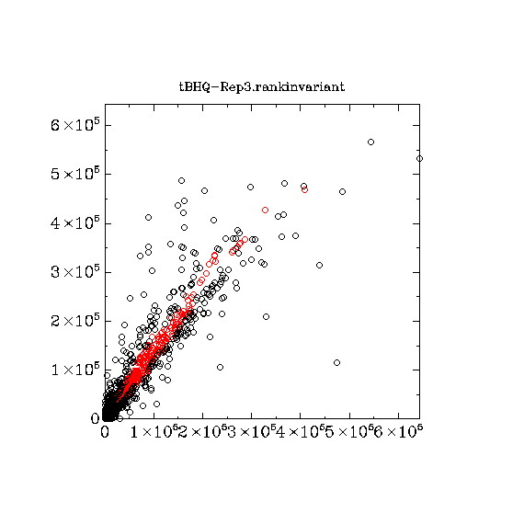
Normalization
Each sample is hybridized to its own microarray
Dye normalization is needed to factor out microarray loading error
Non-linear scaling method based on rank invariant probes (see lab)
Result is reliable estimates of relative transcript abundance not fold change estimates
pre-normalization
microarray #2
microarray #1
Cy3 intensity between two samples. Putative housekeeping genes in red – expected to be in equal abundance in both samples. Non-linear normalization needed based on plot above.

Slide 20
Normalization
Each sample is hybridized to its own microarray
Dye normalization is needed to factor out microarray loading error
Non-linear scaling method based on rank invariant probes (see lab)
Result is reliable estimates of relative transcript abundance not fold change estimates
pre-normalization
microarray #2
microarray #1
Cy3 intensity between two samples. Putative housekeeping genes in red – expected to be in equal abundance in both samples. Non-linear normalization needed based on plot above.

Slide 21
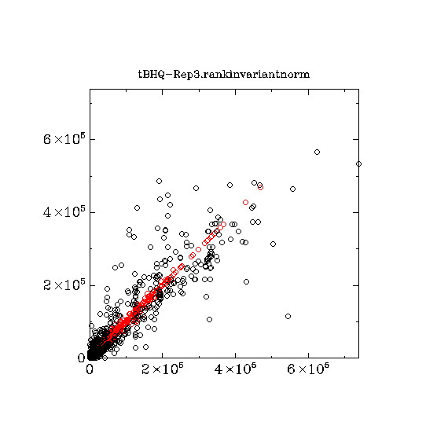
Normalization
Each sample is hybridized to its own microarray
Dye normalization is needed to factor out microarray loading error
Non-linear scaling method based on rank invariant probes (see lab)
Result is reliable estimates of relative transcript abundance not fold change estimates
post-normalization
microarray #2
microarray #1
Cy3 intensity between two samples. Putative housekeeping genes in red – expected to be in equal abundance in both samples. Non-linear normalization needed based on plot above.

Slide 22
Flow Chart
cDNA synthesis and Cy3/5 labeling
Hybridize to Microarray
RNA extraction
Dry & Scan
Feature Extraction
Data Transformations & Adjustments
Normalization
Data Filtering
Statistical Tests
Post-hoc Tests
Visualization

Slide 23
Filtering
Saturated probes – Cy3 signal at it’s maximum – all probes hybridized
Probes not above background
within 2.6 x standard error of background
Non-uniform probes
Poorly replicated probes

Slide 24
Flow Chart
cDNA synthesis and Cy3/5 labeling
Hybridize to Microarray
RNA extraction
Dry & Scan
Feature Extraction
Data Transformations & Adjustments
Normalization
Data Filtering
Statistical Tests
Post-hoc Tests
Visualization

Slide 25
Experimental Design
BaP Replicate #1
hybridization #1
Probe #59 (CYP19) Cy3 = 51
BaP Replicate #2
hybridization #5
Probe #59 (CYP19) Cy3 = 59
Average BaP = 57.7
BaP Replicate #3
hybridization #6
Probe #59 (CYP19) Cy3 = 63
Average BaP / DMSO = 0.49
Exposure to BaP results in a 2.04 fold decrease in CYP19 transcript abundance compared to DMSO control
DMSO Replicate #1
hybridization #4
Probe #59 (CYP19) Cy3 = 105
DMSO Replicate #2
hybridization #2
Probe #59 (CYP19) Cy3 = 130
Average DMSO = 117.7
DMSO Replicate #3
hybridization #3
Probe #59 (CYP19) Cy3 = 118
Normalized values are quantitative and have normal statistical properties
Mean, standard error, and ANOVA calculations follow normal formulas

Slide 26
Data Transformations
Log transformation
Correction for fold change data in two dye experiments
2 fold increase = 2.0
no change = 1.0
2 fold decrease = 0.5
Reduce mean and variance relationships in one dye experiments
reduce Type I and Type II error
Median centering
Focus analysis upon variation in the data, not magnitude
Important so analysis is not biased toward most abundant transcripts

Slide 27
Flow Chart
cDNA synthesis and Cy3/5 labeling
Hybridize to Microarray
RNA extraction
Dry & Scan
Feature Extraction
Data Transformations & Adjustments
Normalization
Data Filtering
Statistical Tests
Post-hoc Tests
Visualization

Slide 28
Statistical Significance - Replication
Microarrays use familiar statistical tests such at t-test and ANOVA
Increased replication within treatments increases statistical power among treatments
Glass slide microarrays are expensive so many experiments only use triplication
BeadChip microarrays are cheaper and often use higher replication
Average BaP / DMSO = 0.49
Exposure to BaP results in a 2.04 fold decrease in CYP19 transcript abundance compared to DMSO control
t-test with p<0.05

Slide 29
Statistical Significance - Error
Type I error
false positive or false discovery
controlled by the significance level of the test (α), e.g. α=0.05
Type II error
false negative
has value β but often actual value is unknown
related to Power of the test (1 – β) and experimental replication
Average BaP / DMSO = 0.49
Exposure to BaP results in a 2.04 fold decrease in CYP19 transcript abundance compared to DMSO control
t-test with p<0.05

Slide 30
Statistical Significance - Error
Microarrays perform multiple tests, inflating false positives
Traditional statistics use the Bonferroni correction α/n where n = # tests, but this is often not appropriate for microarrays
Microarrays methods often instead estimate the false discovery rate (FDR) and use arbitrary cut-offs
Microarray methods often permutate appropriate FDR test distributions
Agilent zebrafish microarray has 43,803 probes
Each spot measures Cy3 for a single probe (i.e. gene) and each spot undergoes it’s own significance test. Thus there are 43,803 tests performed on the same mRNA sample – the tests are not independent!

Slide 31
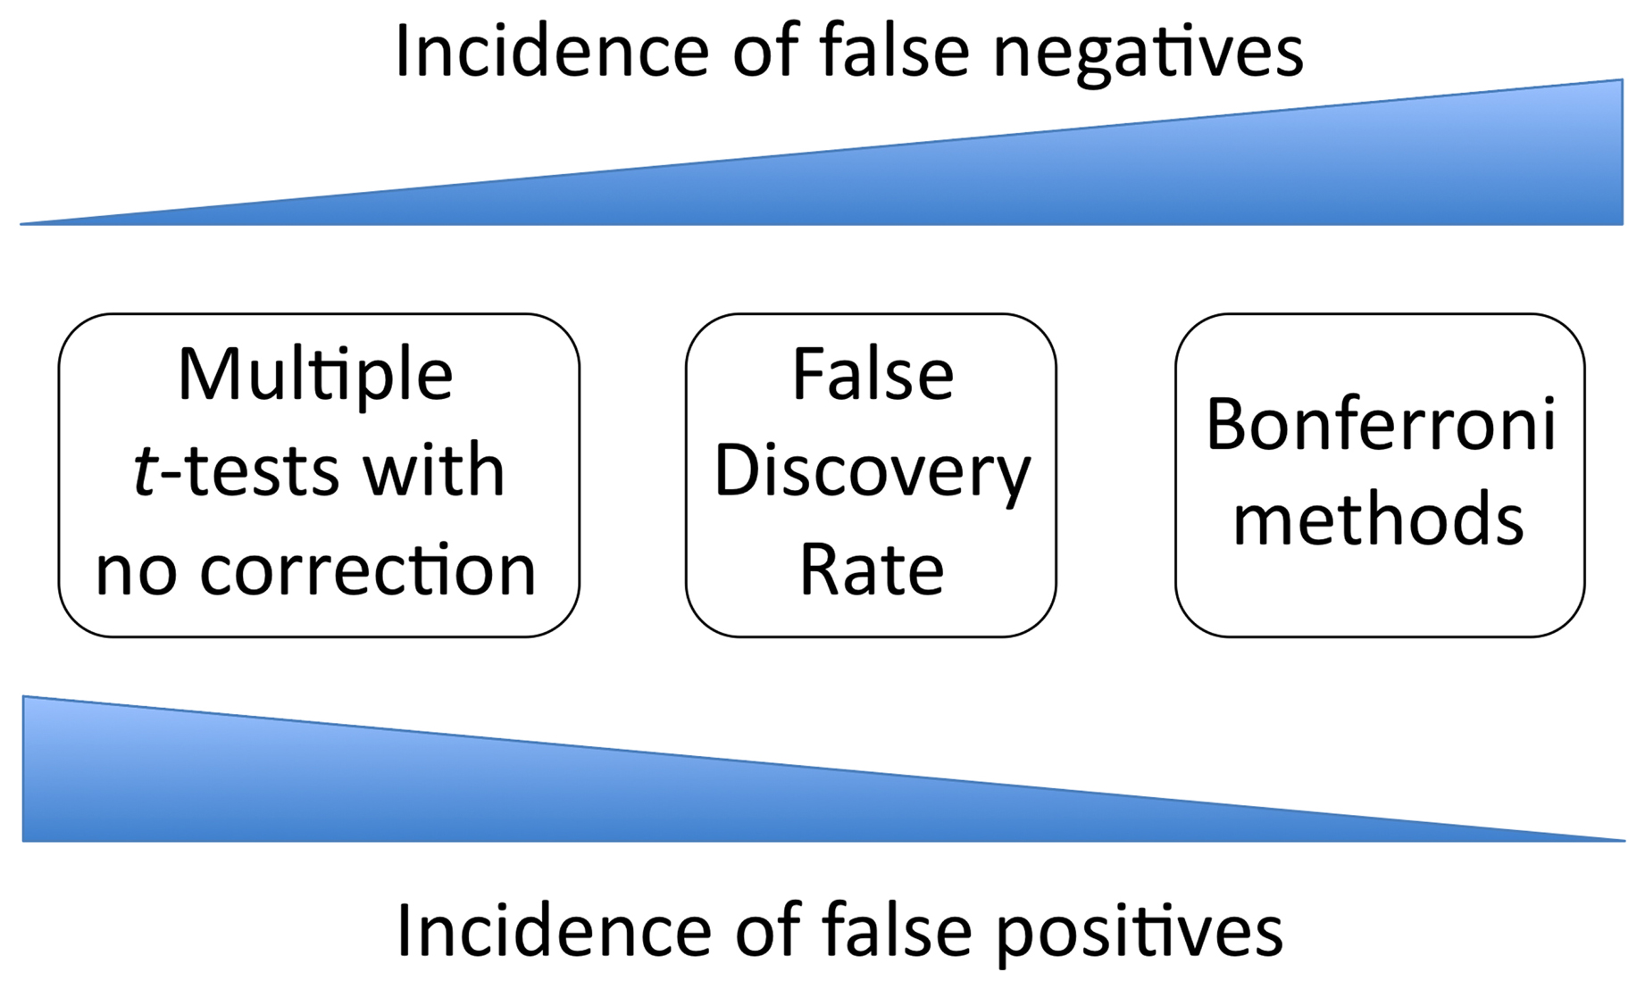
Statistical Significance - Error
The more t-tests you run on the same mRNA sample, the greater the chance of obtaining a statistically significant result through chance sampling
Microarrays thus have the unavoidable presence of false-positive findings (Type I errors)
http://www.wormbook.org/chapters/www_statisticalanalysis/statisticalanalysis.html
Traditional corrections (i.e. Bonferroni) only work for small number of multiple tests; FDR permutations are a compromise for microarrays to use reasonable Type I and Type II error
Q-values are the name given to the adjusted p-values found using an optimized FDR approach, http://www.nonlinear.com/support/progenesis/comet/faq/v2.0/pq-values.aspx

Slide 32
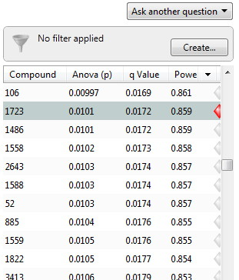
Statistical Significance – Metabolomics Example
Order the results by q-value, Compound #1723 is the 800th compound in the list of 3516 total compounds
Compound #1723 has p=0.0101 and q=0.0172
A p-value of 0.0101 implies a 1.01% chance of false positives in the experiment. 0.0101 x 3516 = 35.51 false positives in the top 800 hits
A q-value of 0.0172 implies only 1.72% of the top 800 compounds are false positives = 800 * 0.0172 = 13.76 false positives
p-values are biased by 3516 multiple tests, q-values correct for this effect

Slide 33
Flow Chart
cDNA synthesis and Cy3/5 labeling
Hybridize to Microarray
RNA extraction
Dry & Scan
Feature Extraction
Data Transformations & Adjustments
Normalization
Data Filtering
Statistical Tests
Post-hoc Tests
Visualization

Slide 34
Visualization
Heat Maps
variety of clustering algorithms
clusters of co-variation may indicate common regulatory pathways
particularly good for time series data

Slide 35
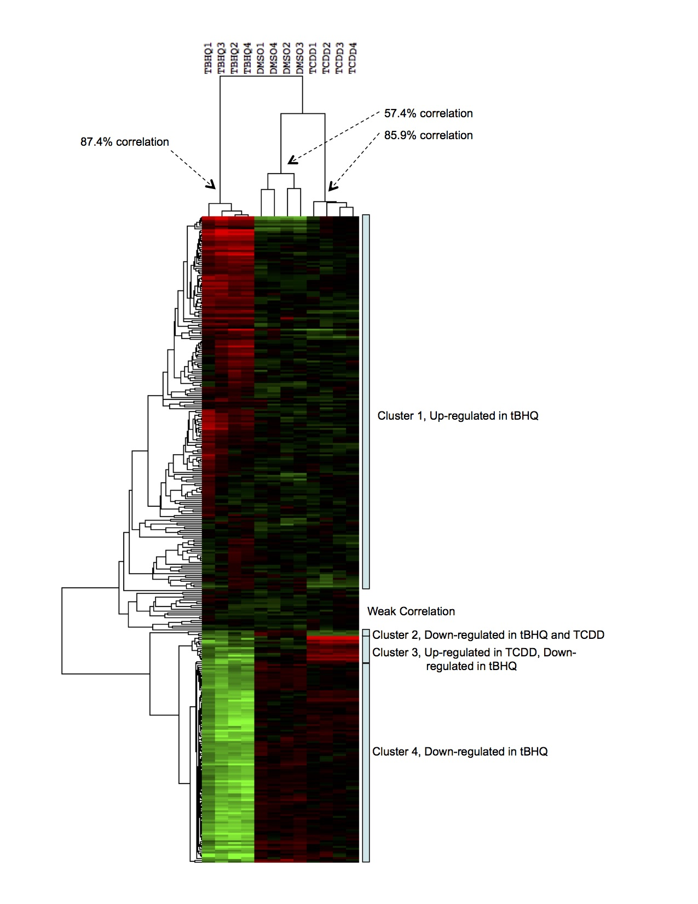
Visualization
Lab 4
Cluster by genes (rows) and / or treatments (columns)
Clusters are hierarchical
Smaller clusters have higher correlation in expression patterns
Median centre to downplay abundance and focus analysis on patterns

Slide 36
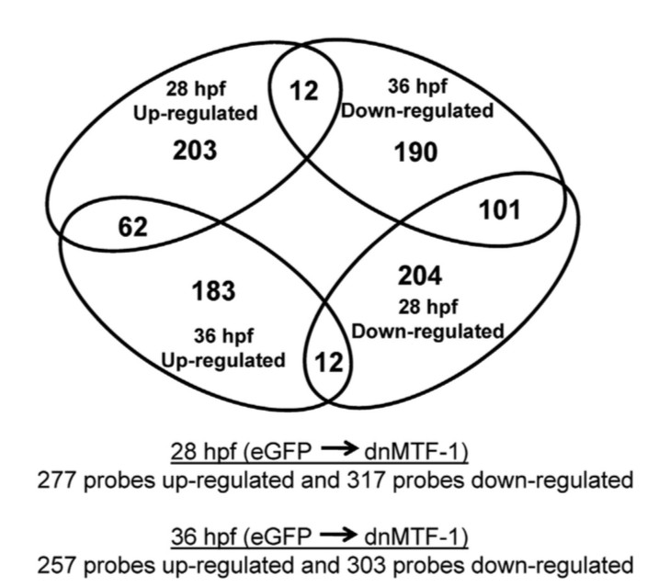
Visualization
Heat Maps
variety of clustering algorithms
clusters of co-variation may indicate common regulatory pathways
particularly good for time series data
VENN diagrams
excellent for visualizing shared response and designing follow-up experiments

Slide 37
Visualization
Heat Maps
variety of clustering algorithms
clusters of co-variation may indicate common regulatory pathways
particularly good for time series data
VENN diagrams
excellent for visualizing shared response and designing follow-up experiments
Principal Component Analysis (PCA)
powerful tool for trend analysis
look at the genes involved in the trends – what are they?
use DAVID for Gene Ontology term enrichment analysis for genes involved in trends

Slide 38
Conclusions
Design of the experiment and the microarray probes critical
How many probes?
Quality of probes for each gene?
Coverage of the transcriptome and target genes?
Coverage of the genome and hypothetical genes?
Multiple probes for genes?
Design and analysis involve trade-offs
Level of replication, experiment cost, statistical power
Replication costs: BeadChip < microarray < RNA-Seq
Subtle data may require permissive analyses
Allow higher false discovery rate?
Downplay variance (e.g. rank product methods)?
Visualization and post-hoc tests needed when large numbers of probes are significant

Slide 39
Conclusions
Independent verification often required
Quantitative PCR verification of selected results
Gene knockdown or over-expression experiments
Trust and Reliability
Robust experimental design, microarray probes, and statistical analyses engender trust of overall results
Subtle results, high variation, or downplaying of error require more extensive independent verification of overall results
Interpretation of overall results can be difficult
Fold change versus biological relevance
Poorly understood genes
Prediction of underlying biological processes
GO enrichment? Interactome analyses? KEGG?

Slide 40
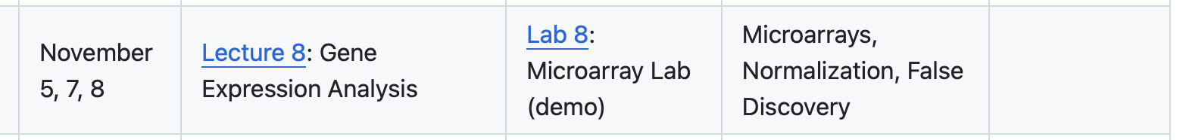
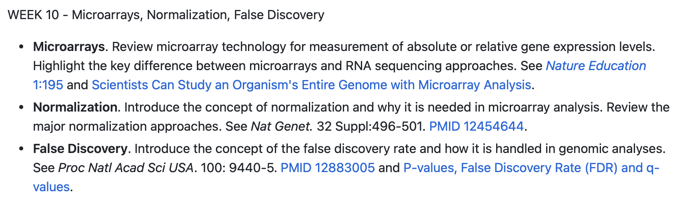
This week...

